Slide 1

Hospitality Domain Presentation
by – Pallavi Rakshe

Slide 2
Hospitality Industry
Hospitality is known as travel and tourism.
It provides accommodation, food & drinks and other facility required by guest.
Hospitality is a glamour industry. It refers to the relationship between guest and host i.e. reception, visitors and strangers etc.
Atiq Grands owns multiple five-star hotels across India. They have been in the hospitality industry for the past 20 years. Due to strategic moves from other competitors and ineffective decision-making in management, Atiq Grands are losing its market share and revenue in the luxury/business hotels category.

Slide 3
About Hospitality Data Source & Data Modelling & relations between tables
Data Source consists of total 5 tables and 1 metric list excel file. The tables are as follows: 1) dim_date 2) dim_hotels 3) dim_rooms 4) fact_aggregated_bookings 5) fact_bookings
Data Modelling : First three tables is having 1 to many relationships with fact_bookings and fact_aggregated _bookings table.

Slide 4
Key Insights
The total Revenue for the analyzed period was 1.7 Bn.
The Occupancy Percentage analyzed is 57.86%.
Cancellation Rate is 24.83 %
Total Booking analyzed is 134590.
Trend analysis observed by week wises, week 22 is having highest revenue of 1.49 % and lowest is week 26 0.86 %.
Weekend and Weekday total revenue observed weekday is having highest total revenue.
Based on classwise revenue Elite is having highest total Revenue.

Slide 5
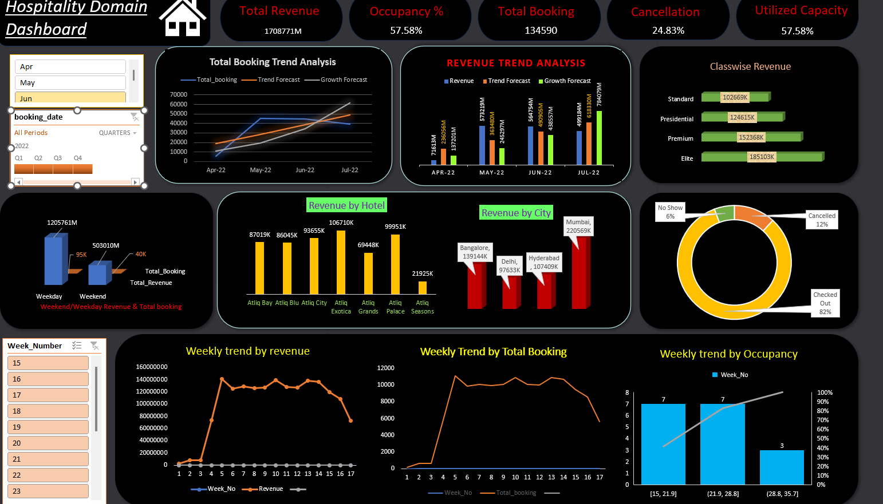
Excel Dashboard

Slide 6
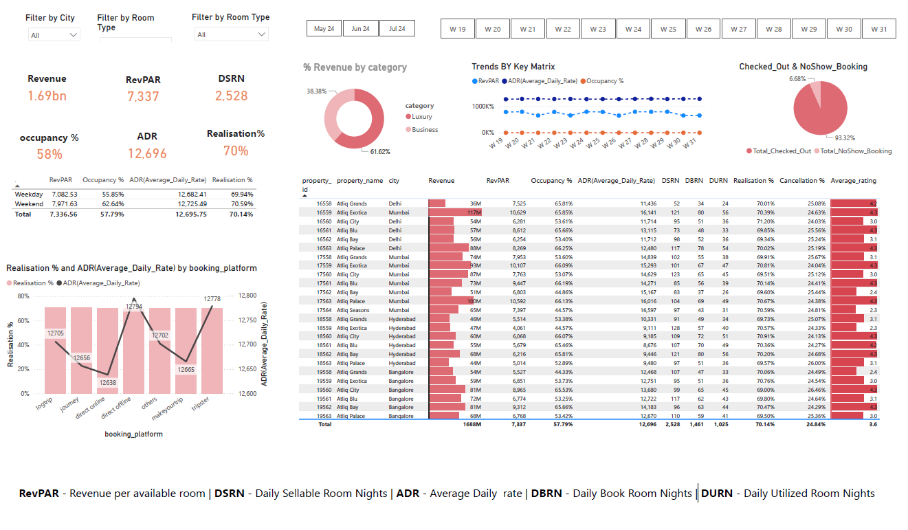
PowerBI Dashboard

Slide 7
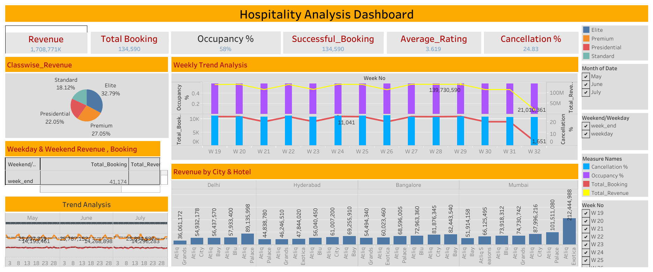
Tableau Dashboard

Slide 8
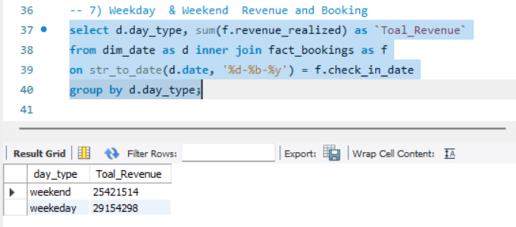
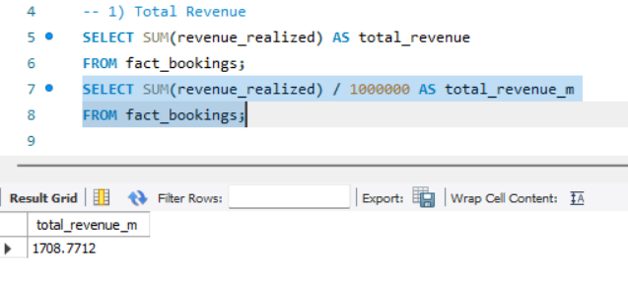
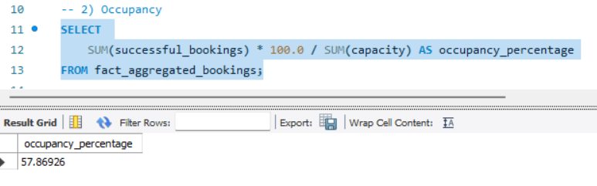
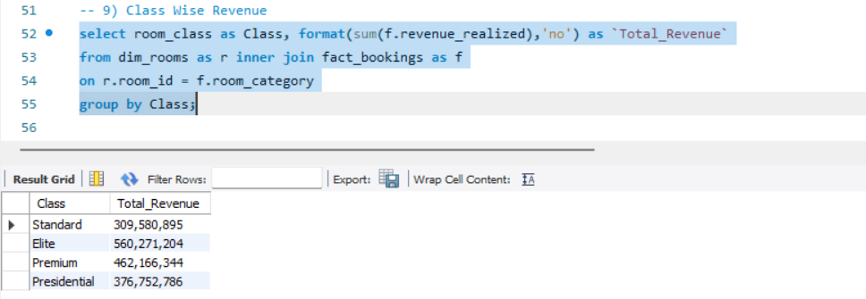
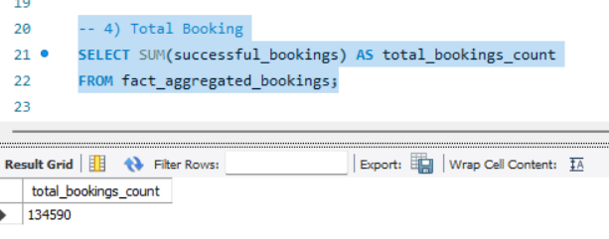
SQL

Slide 9
Thank You

